Slide 1
Tweets Analyzer
Khushal patel

Slide 2
Motivation
Description
Implementation
Live Demo

Slide 3
Motivation
What does a tweet/retweet say about the user who posted it
Leverage Big Data technologies to have better sense of data
Sentiment Analysis
TF-IDF scores
Spark (Mappers and Reducers)
Real Time Analysis
Data Visualization

Slide 4
Description
User profiling based on tweets:
Hashtags
Sentiments
TD-IDF topic of the tweet
Example: User X tweeted:
“#UnitedAirlines has poor customer service “
Hashtag: #UnitedAirlines
Sentiment: Negative
TF-IDF topics: UnitedAirlines, customer service

Slide 5
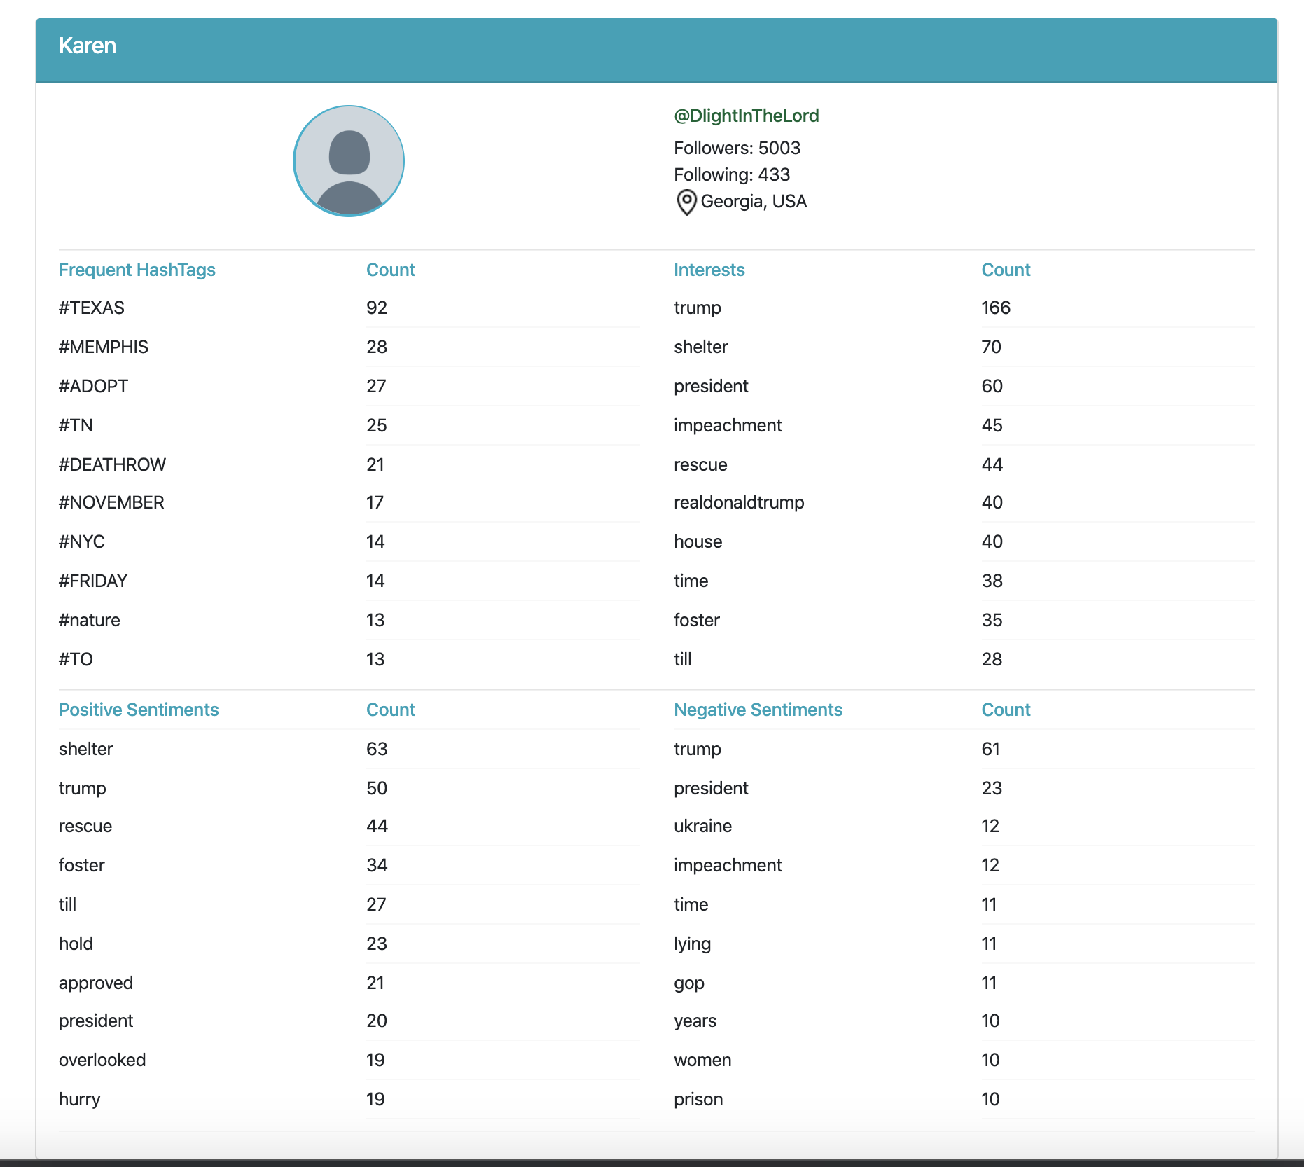

Slide 6
Implementation
Data processing
Data storage
Web application

Slide 7
Data Processing
Divided into three python scripts:
Twitter App (twitter_app.py)
Twitter Client (twitter_client.py)
User Profile Builder (user_profile_builder.py)

Slide 8
Twitter App
Send ID
Twitter Client
Ready to receive
Live tweets
Build Profile
Twitter API
Make User Profile
Get user tweets
Save to DB

Slide 9
Twitter App
Connect to twitter server using Twitter API
Listen for certain tweets in real time
You can mention list of keywords to track
Once tweet is received, extract user id
Send the user id to twitter_client.py

Slide 10
Twitter App
Send ID
Twitter Client
Ready to receive
Live tweets
Build Profile
Twitter API
Make User Profile
Get user tweets
Save to DB

Slide 11
Twitter Client
Receives twitter id
Run user_profile_builder.py
Signal twitter_app.py to send a new id
Repeat

Slide 12
Twitter App
Send ID
Twitter Client
Ready to receive
Live tweets
Build Profile
Twitter API
Make User Profile
Get user tweets
Save to DB

Slide 13
User Profile Builder
Receives twitter user id
Gets most recent tweets of the user using Twitter API
Perform sentiment analysis, get topics using TF-IDF scores and extract hashtags
Save profile to the database

Slide 14
Twitter App
Send ID
Twitter Client
Request ID
Live tweets
Build Profile
Twitter API
Make User Profile
Get user tweets
Save to DB

Slide 15
DEMO

Slide 16
Data Storage
Redis Database
NoSQL, non-Relational database
In memory key-value pairs
Offers data structures like strings, lists, sets, map
Faster results for queries like “Get top 10 entries”

Slide 17
Web Application
To Visualize our Analysis
Back End:
Make calls to database and retrieve user profiles
Node JS
Front End:
Interactive UI to display profiles and allow searching for:
topics
hashtags
specific user
Angular

Slide 18
DEMO

Slide 19
Technologies Used
Data Processing
Python
Apache Spark
Machine learning libraries: sentiment analysis and sklearn for TF-IDF
Data Storage
Redis
Web Application
Node + Express JS
Angular
Bootstrap

Slide 20
References
TF-IDF:
Juan Ramos. Using TF-IDF to Determine Word Relevance in Document Queries. Retrieved from http://citeseerx.ist.psu.edu/viewdoc/download?doi=10.1.1.121.1424&rep=rep1&type=pdf
Twitter API:
(n.d.). Docs - Twitter Developers. Retrieved from https://developer.twitter.com/en/docs.html
Sentiment Analysis
https://www.nltk.org/api/nltk.sentiment.html
Redis:
https://redis.io/

Slide 21
THANK YOU
Q&A

